Slide 1


Department of Computer Science And Engineering
CMR TECHNICAL CAMPUS
(UGC Autonomous)
2020-2024
Major Project
A MACHINE LEARNING METHODOLOGY FOR DIAGNOSING CHRONIC KIDNEY DIESEASE
Under the Guidance of
DR.V. NARESH KUMAR
(Associate Professor)
BY
SARA : 207R1A05N8
ANUMULA ABHITEJ REDDY : 207R1A05J7

Slide 2
TABLE OF CONTENTS
Introduction
Existing System
Proposed System
Hardware and Software Requirements
Novelty of our Project
Architecture
Modules
Results
Conclusion
Future Scope
References

Slide 3
ABSTRACT
Chronic Kidney Disease (CKD) is one of worldwide medical challenges with high morbidity and death rate. Since there is no symptom during the early stages of CKD, patients often fail to diagnose the disease.
Patients with HIV have more chances to be affected with CKD in critical condition. Early detection of CKD helps patients to obtain prompt care and delays the further progression of disease. With the availability of pathology data, the use of machine-learning techniques in healthcare for the classification and prediction of disease has become more common.
This project presents the classification of CKD using machine learning models. Based on the glomerular filtration rate, the CKD stages are also calculated for patients diagnosed with CKD. DNN model outperforms with 99% accuracy in classifying CKD patients with HIV.

Slide 4
EXISTING SYSTEM
The existing system predicts the chronic diseases which are for a particular region and for the particular community.
CKD is not identified in the early stages.
In this System, Big Data & CNN algorithms are used for Disease risk prediction.
The accuracy of the Existing System is up to 94.8%

Slide 5
EXISTING SYSTEM DISADVANTAGES
Limited Scope of Diseases
Lacks the capability to identify CKD Stages
Dependency on Data Quality and Availability

Slide 6
PROPOSED SYSTEM
In the proposed system for Chronic Kidney Disease (CKD) classification, a diverse set of machine-learning algorithms is harnessed to determine whether a patient has CKD. Four models, namely K-nearest neighbors (KNN), Support Vector Machine (SVM), Random Forest and Logistic Regression.
SVM is employed as a supervised learning model, while KNN predicts values by comparing patient features with the training dataset. Decision trees are used for visual representation but are often limited in accuracy. Random Forest addresses this limitation by combining multiple decision trees.
A feature selection method is applied to optimize the model's performance by eliminating unnecessary features.

Slide 7
PROPOSED SYSTEM ADVANTAGES
Diverse Algorithmic Approach
Supervised Learning with SVM
KNN for Comparative Analysis
Random Forest for Enhanced Accuracy
Feature Selection Optimization
Improved Accuracy and Reliability

Slide 8
HARDWARE REQUIREMENTS
Processor : AMD Ryzen 4800U
RAM : 8 GB
Hard Disk : 20 GB

Slide 9


SOFTWARE REQUIREMENTS
Coding Language : Python.
Front-End : Html, CSS, Javascript
Back-End : Django-ORM
Database : MySQL(XAMPP server)

Slide 10
NOVELTY of project
Integration of Diverse Machine Learning Algorithms
Utilization of Ensemble Learning Techniques
Feature Selection Optimization for Enhanced Performance
Comprehensive Diagnostic System Incorporating Neural Networks
Holistic Approach to CKD Classification with Comparative Analysis

Slide 11
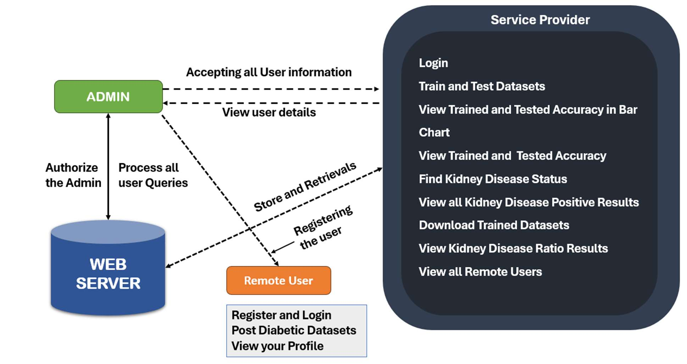
SYSTEM ARCHITECTURE

Slide 12
Modules
SERVICE PROVIDER
Login / Register
Train and Test Datasets
View Trained and Testes Accuracy in Bar Chart
Find Kidney Disease Status
Find Kidney Disease Ratio
View All Kidney Disease Positive Details
Download Trained Datasets
View Kidney Disease Ratio Results
View All Remote Users
REMOTE USER
Login / Register
Post Diabetic Datasets
View Profile

Slide 13
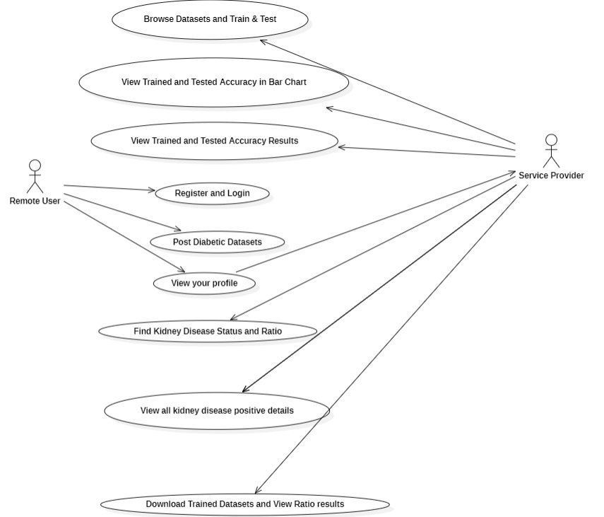
Use Case Diagram

Slide 14
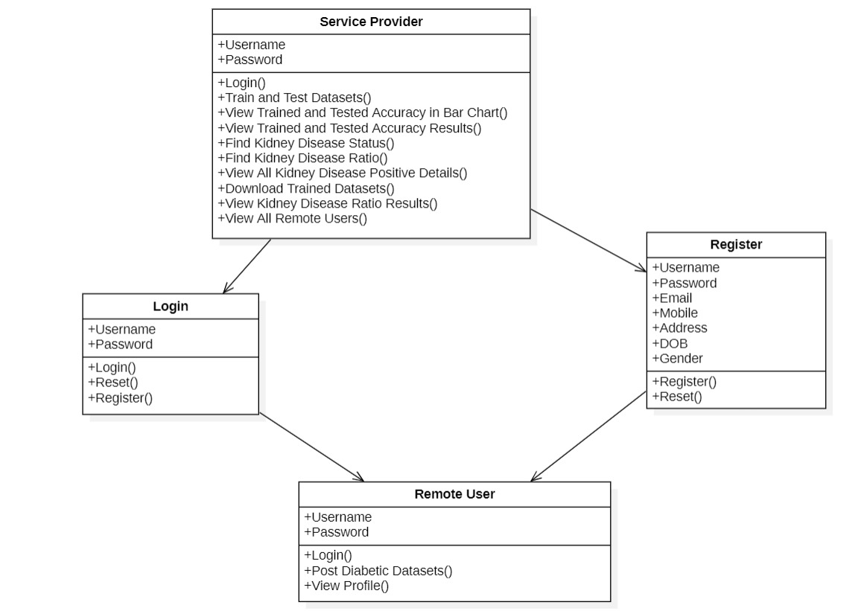
Class Diagram

Slide 15
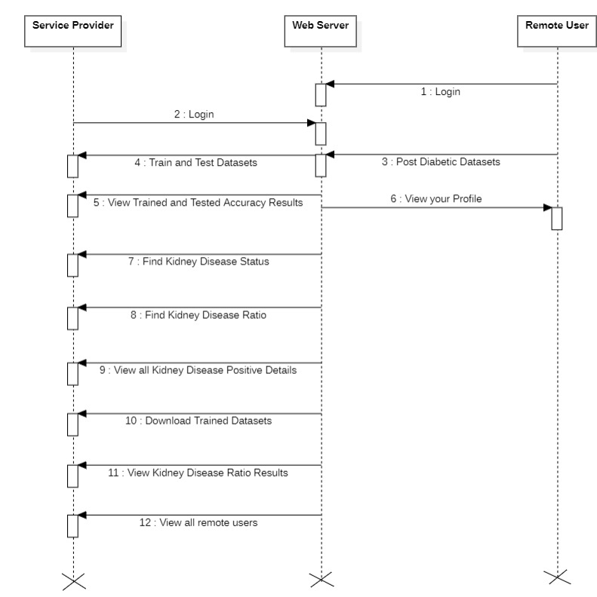
Sequence Diagram

Slide 16
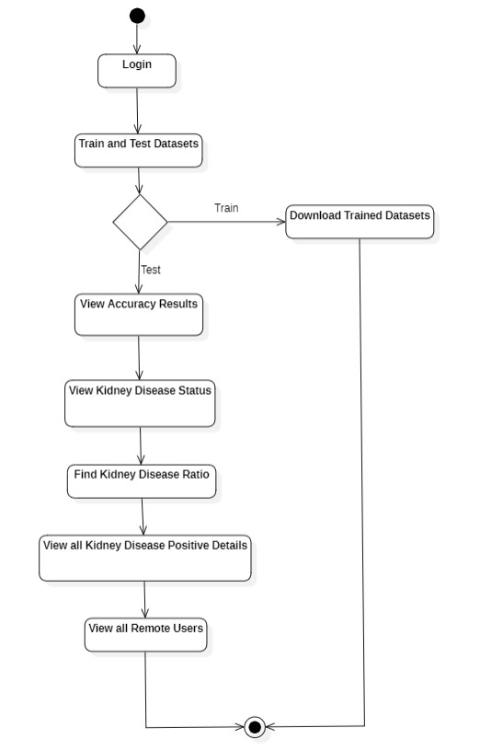
Activity Diagram

Slide 17
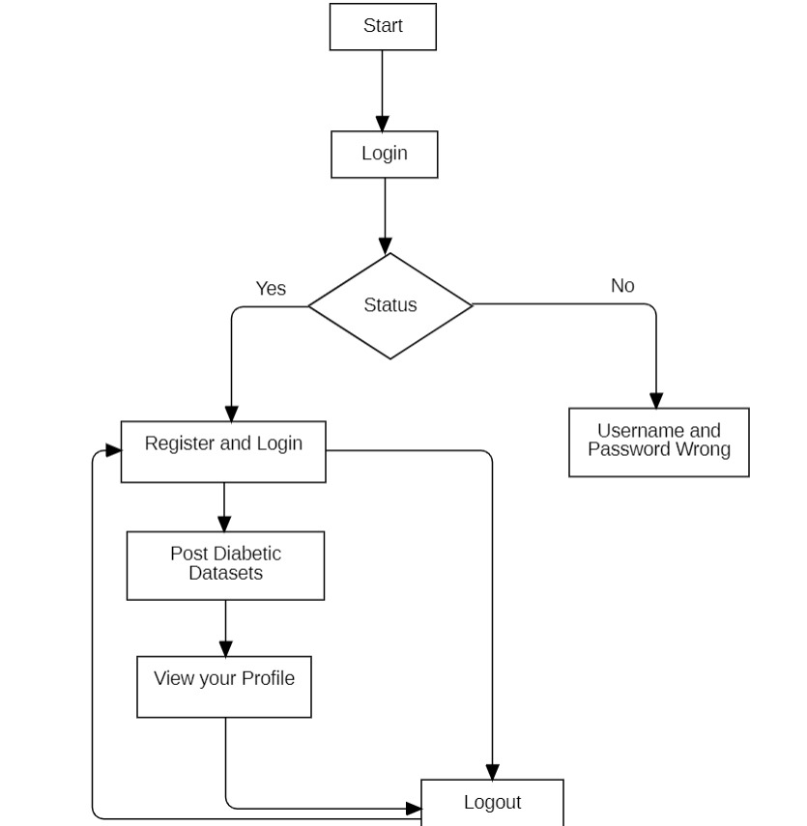
Flow chart – remote user

Slide 18
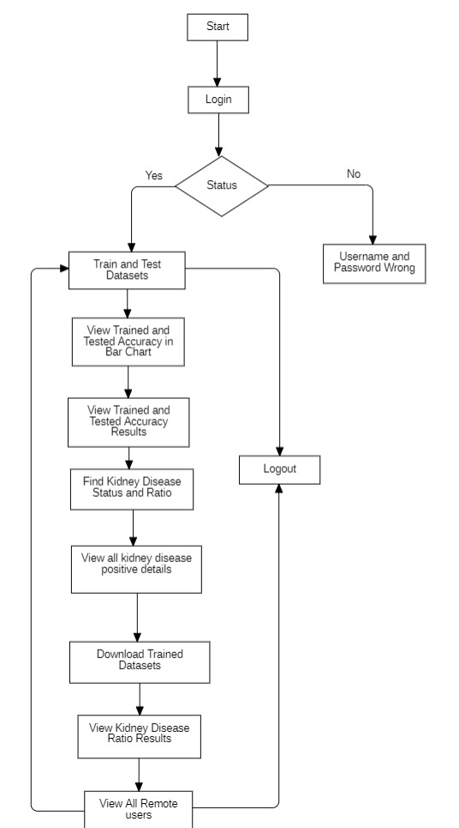
Flow chart – Service provider

Slide 19

Screenshots
Service Provider login

Slide 20
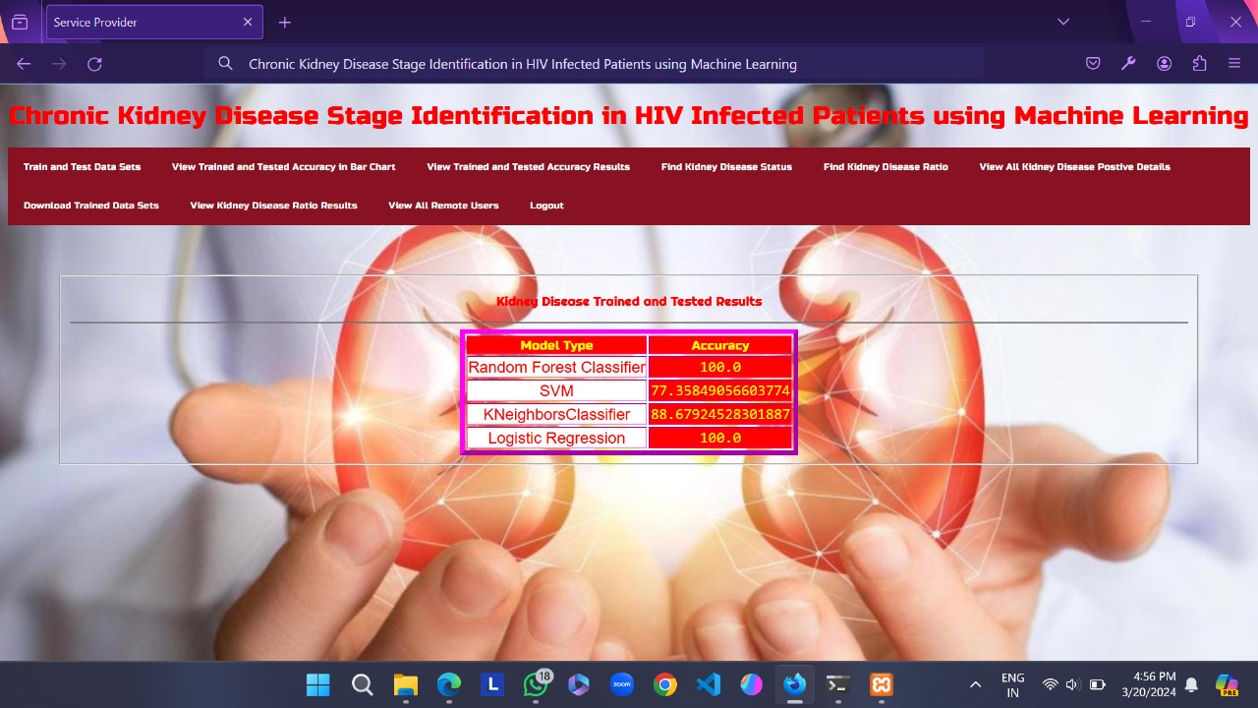
Screenshots
Train and Test Datasets

Slide 21
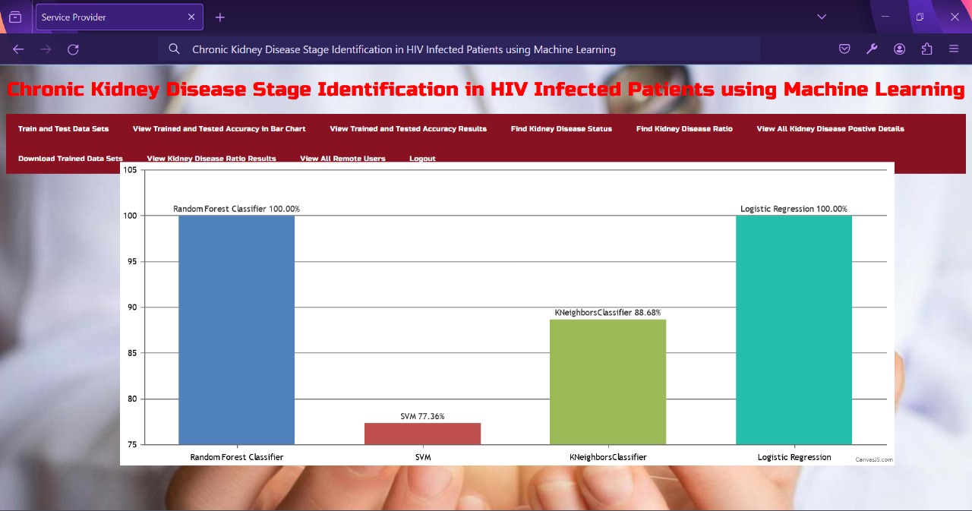
Screenshots
View Trained and Tested Accuracy in Bar Chart

Slide 22
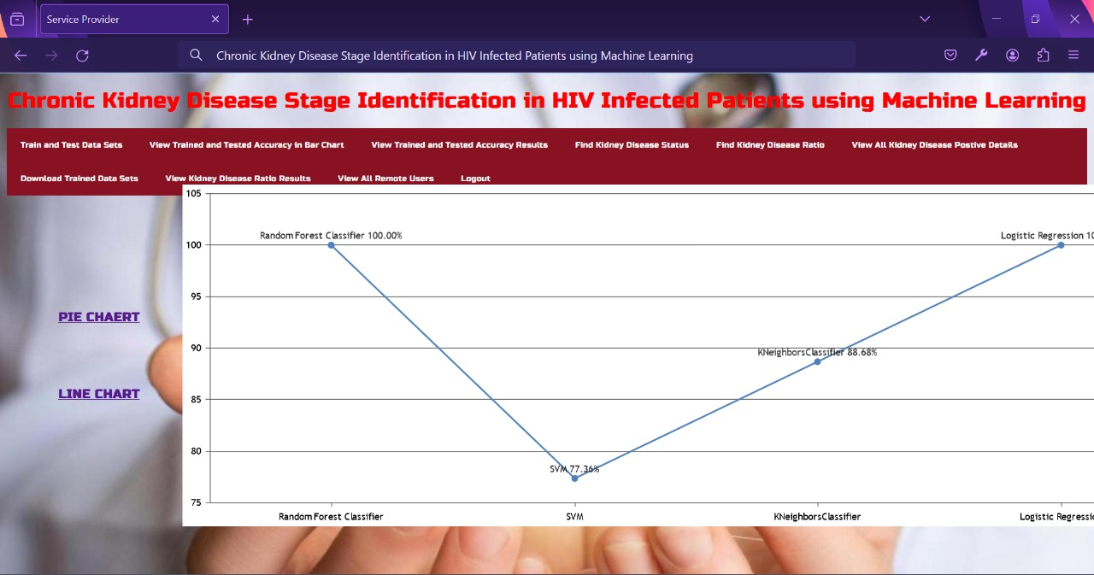
Screenshots
View Trained and Tested Accuracy Results in Line Chart

Slide 23
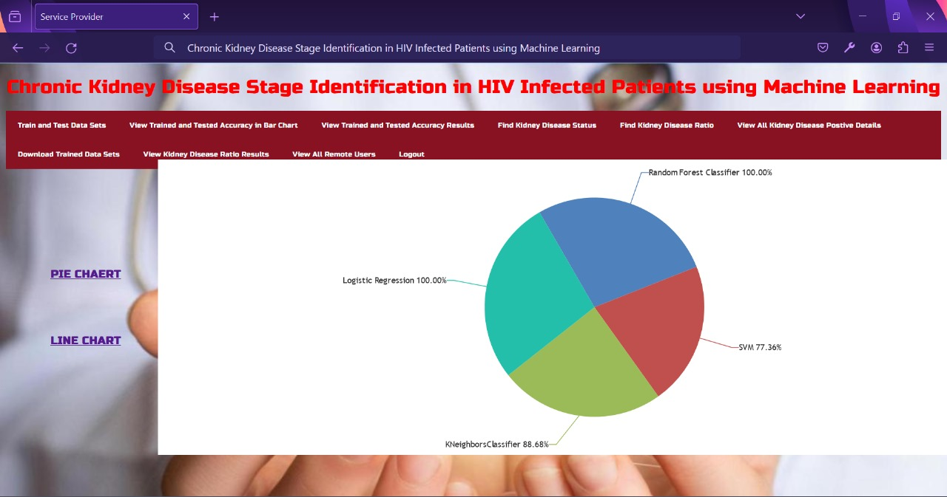
Screenshots
View Trained and Tested Accuracy Results in Pie Chart

Slide 24
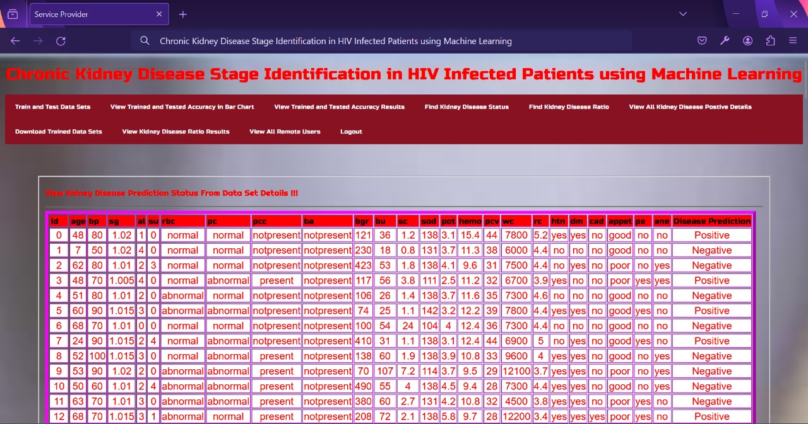
Screenshots
Find Kidney Disease Status

Slide 25
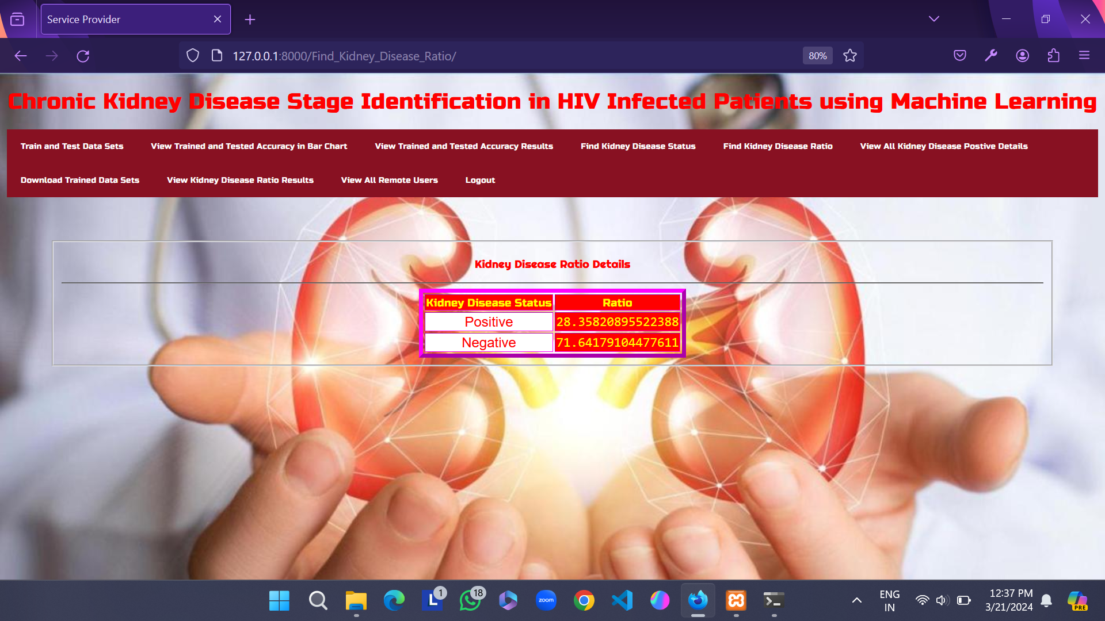
Screenshots
Kidney Disease Ratio Details

Slide 26
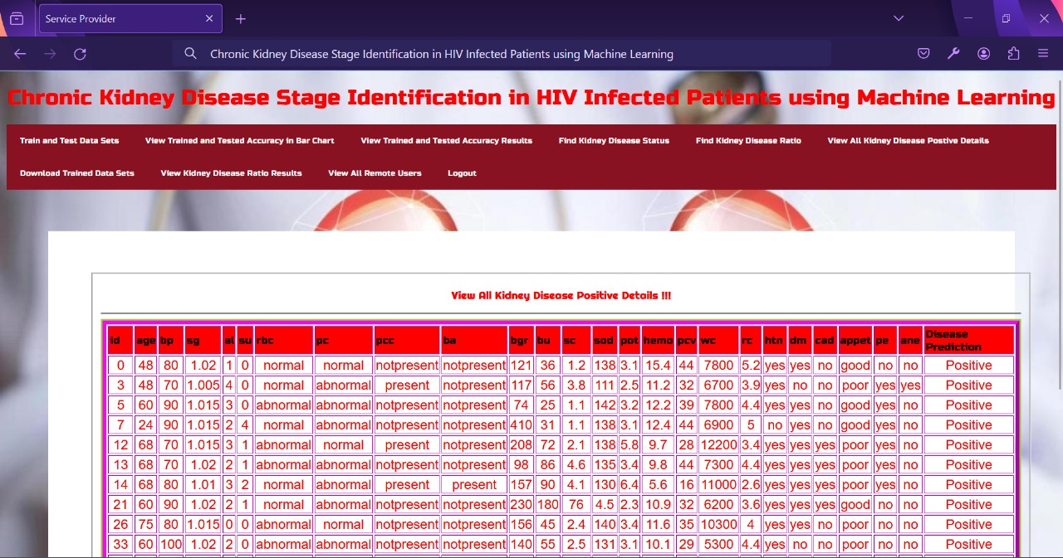
Screenshots
View All Kidney Disease Positive Details

Slide 27
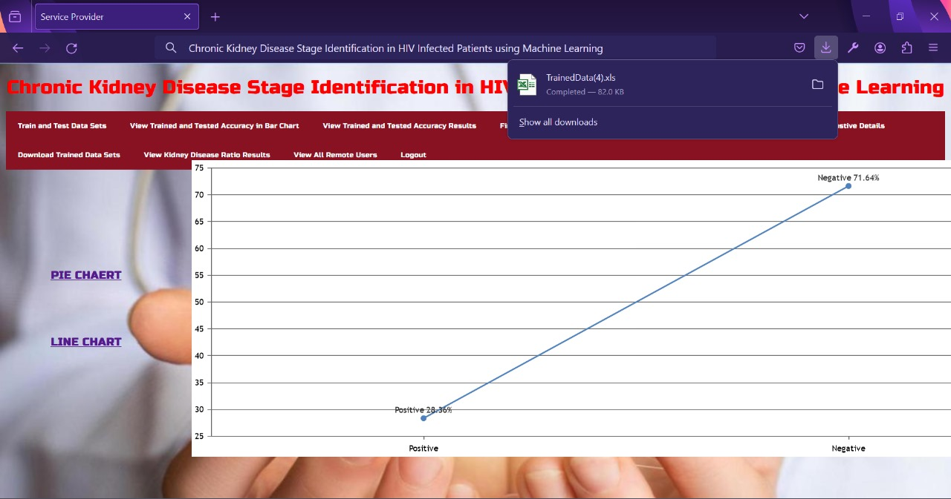
Screenshots
Download Trained Datasets

Slide 28
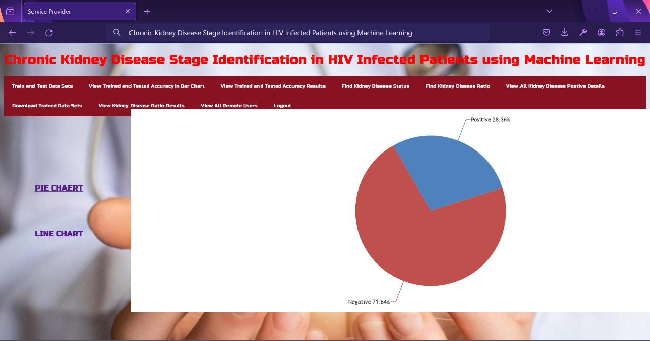
Screenshots
View Kidney Disease Ratio Results

Slide 29
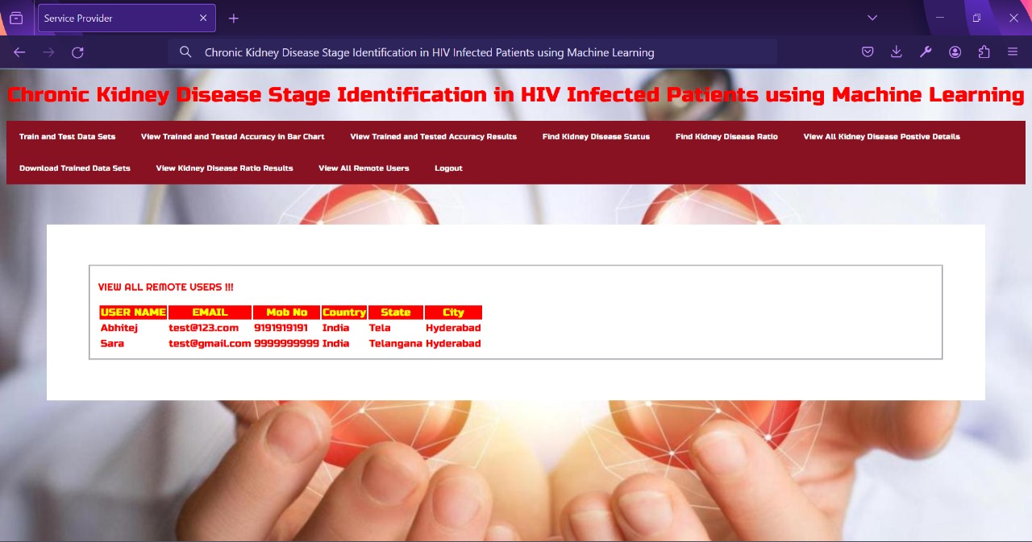
Screenshots
View All Remote Users

Slide 30

Screenshots
Remote User Login

Slide 31
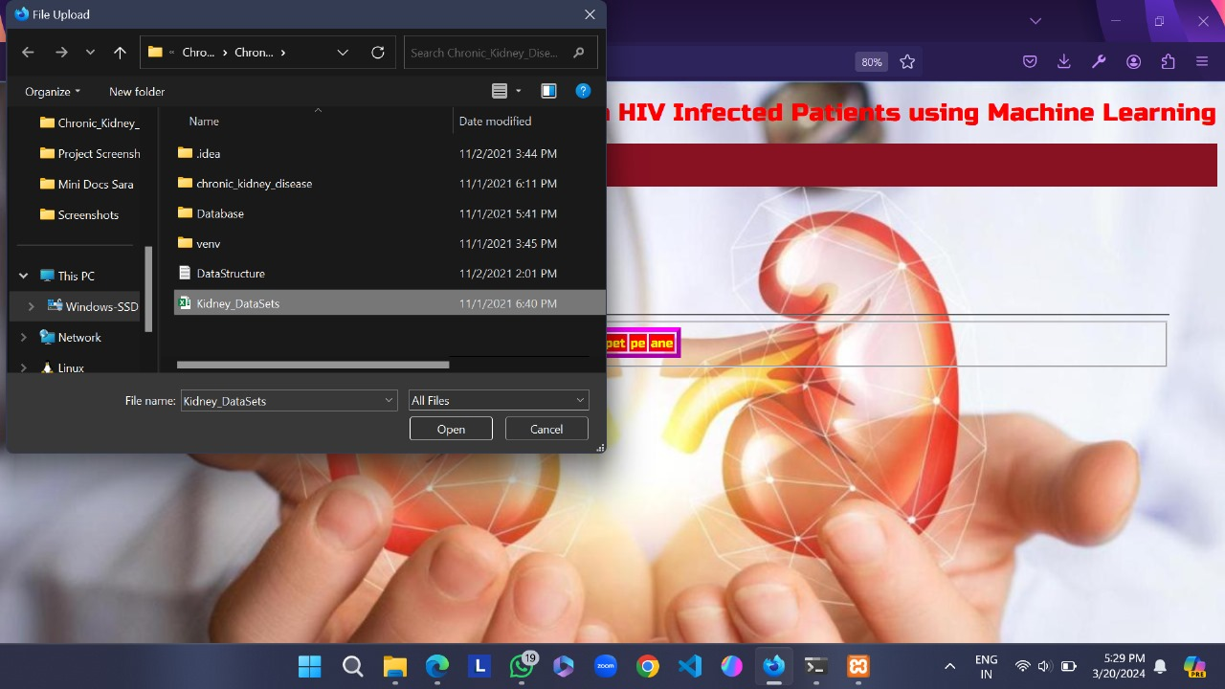
Screenshots
Post Diabetic Datasets

Slide 32
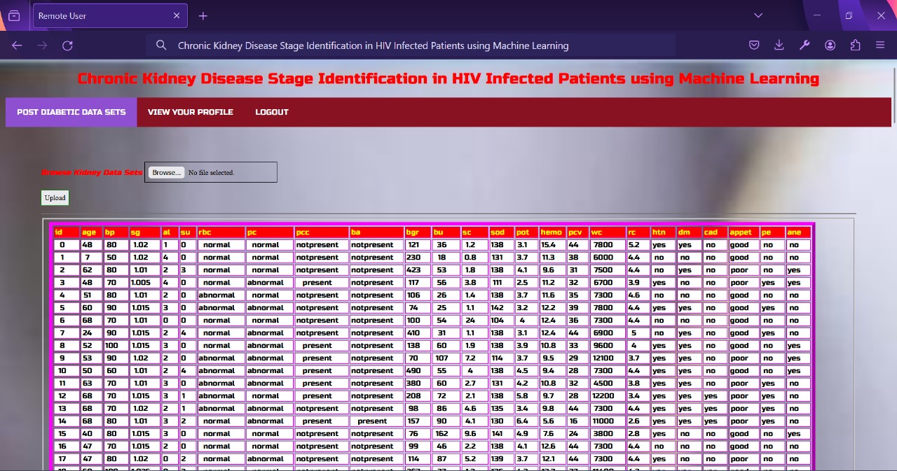
Screenshots
View Posted Diabetic Datasets

Slide 33
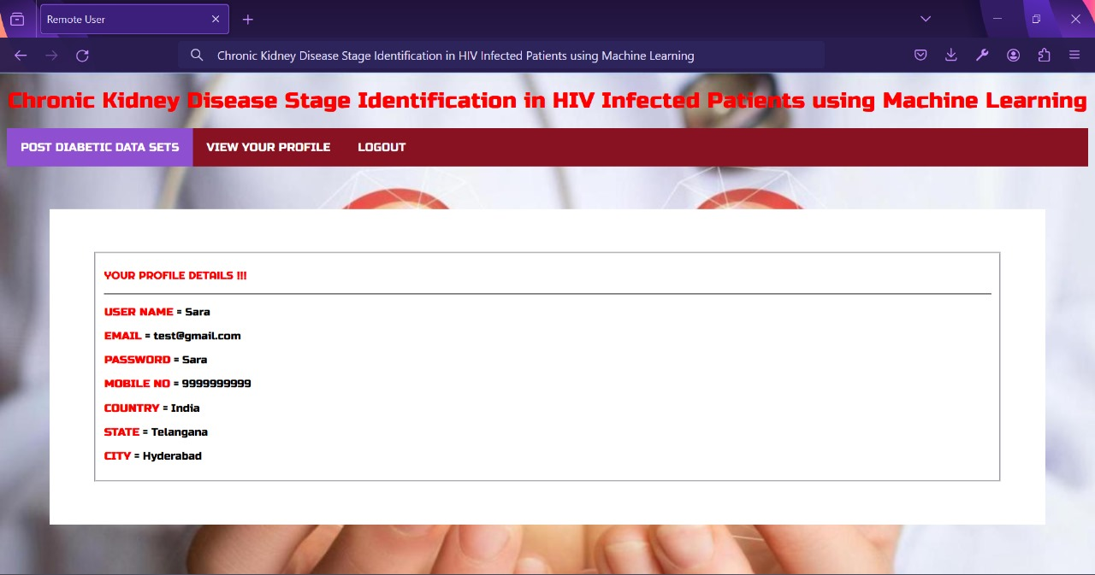
Screenshots
View your Profile

Slide 34
SAMPLE CODE
from django.db.models import Count, Avg
from django.shortcuts import render, redirect
from django.db.models import Count
from django.db.models import Q
import datetime
import xlwt
from django.http import HttpResponse
# Importing the libraries
import pandas as pd
import matplotlib.pyplot as plt
import numpy as np
import seaborn as sns
from sklearn.model_selection import train_test_split
from sklearn.ensemble import RandomForestClassifier
from sklearn.metrics import roc_curve, auc, confusion_matrix, classification_report,accuracy_score
from sklearn.linear_model import LogisticRegression
from sklearn.tree import DecisionTreeClassifier
from sklearn.neighbors import KNeighborsClassifier
from sklearn.svm import SVC

Slide 35
from Remote_User.models import
ClientRegister_Model,kidney_model,kidney_disease_model,detection_ratio_model,detection_accuracy
_model
def serviceproviderlogin(request):
if request.method == "POST":
admin = request.POST.get('username')
password = request.POST.get('password')
if admin == "Admin" and password =="Admin":
detection_accuracy_model.objects.all().delete()
return redirect('View_Remote_Users')
return render(request,'SProvider/serviceproviderlogin.html')
def Find_Kidney_Disease_Ratio(request):
detection_ratio_model.objects.all().delete()
ratio = ""
kword = 'Positive'
print(kword)
obj = kidney_disease_model.objects.all().filter(Q(prediction=kword))
obj1 = kidney_disease_model.objects.all()
count = obj.count();

Slide 36
ratio1 = ""
kword1 = 'Negative'
print(kword1)
obj1 = kidney_disease_model.objects.all().filter(Q(prediction=kword1))
obj11 = kidney_disease_model.objects.all()
count1 = obj1.count();
count11 = obj11.count();
ratio1 = (count1 / count11) * 100
if ratio1 != 0:
detection_ratio_model.objects.create(names=kword1, ratio=ratio1)
obj = detection_ratio_model.objects.all()
return render(request, 'SProvider/Find_Kidney_Disease_Ratio.html', {'objs': obj})
def View_Kidney_Disease_Positive_Details(request):
keyword="Positive"
obj = kidney_disease_model.objects.all().filter(prediction=keyword)

Slide 37
CONCLUSION
Classification of Chronic Kidney diseases stage in HIV infected patient are extremely useful to patients as well as doctor for timely and accurate clinical decisions.
In this project we have compared the performance of state of art machine learning algorithms along with DNN for classification of CKD for patients having HIV.
Our study indicates that DNN has outperformed in CKD classification. We have also shown the use of EGFR formula to identify stages of disease. In future, features based DNN can be combined with medical image analysis to support diagnosis based on different imaging modalities.

Slide 38
Future Scope
Refine Algorithms for Better Accuracy: Continuously improve algorithms by gathering diverse datasets to ensure accurate CKD detection across various demographics, regions, and medical conditions.
Integrate with Electronic Health Records (EHR): Connect the CKD identification system with healthcare providers' electronic health record systems for real-time diagnosis and monitoring, leading to quicker interventions and better patient outcomes.
Personalize Diagnosis and Treatment: Design CKD diagnosis and treatment plans based on individual patient characteristics like genetics, lifestyle, and existing conditions. This involves using machine learning to incorporate genetic and patient-reported data for personalized care.

Slide 39
References
[1] C. I. Bagnis, J. E. Heron, and D. M. Gracey, “Contemporary issues and
new challenges in chronic kidney disease amongst people living with
HIV,” AIDS Res. T her., vol. 17, no. 1, pp. 1 –13, 2020, doi:
10.1186/s12981-020-00266-3.
[2] Y. Liu, C. Liu, J. Qin, L. Chen, C. Feng, and B. Chen, “ A machine
learning met hodology for diagnosing chronic kidney disease,” IEEE
Access, vol. 8, pp. 20991–21002, 2020, doi:
10.1109/ACCESS.2019.2963053.
[3] A. S. Anwar and E. H. A. Rady , “ P redict ion of kidney disease st ages
using dat a mining algorithms,” Informatics Med. Unlocked, vol. 15, no.
March, p. 100178, 2019, doi: 10.1016/j.imu.2019.100178.

Slide 40
References
[4] M. N. Amin, A. Al Imran, and F. T . Johora, “Classificat ion of Chronic
Kidney Disease using Logist ic Regression, Feedforward Neural
Network and Wide Deep Learning,” 2018 Int . Conf. Innov. Eng.
Technol. ICIET 2018, pp. 1–6, 2019, doi: 10.1109/CIET.2018.8660844.
[5] S. D. Sudarsan,N. Chet ty, K. S. Vaisla, “ Role of attribut es select ion in
classificat ion of Chronic Kidney Disease patients,” pp. 1 –6, 2016, doi:
10.1109/cccs.2015.7374193.
[6] E. Perumal , P. Arulanthu , “ P redict ing t he Chronic Kidney Disease
using Various Classifiers,” 4t h Int . Conf. Elect r. Elect ron. Commun.
Comput . Technol. Optim. Tech. ICEECCOT 2019, pp. 70–75, 2019, doi:
10.1109/ICEECCOT46775.2019.9114653.

Slide 41
THANK YOU

